Slide 1
VLSI & EMBEDDED SYSTEMS LAB
INTRODUCTION

Slide 2
ECAD
COMPRISES OF VHDL/VERILOG DESIGN

Slide 3
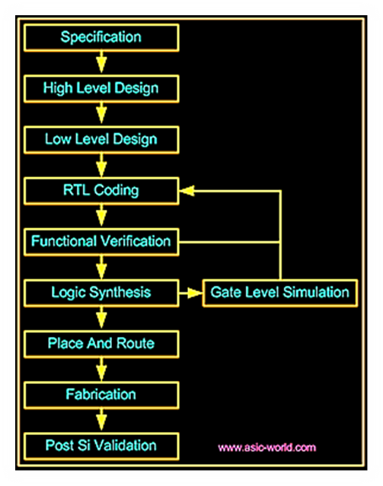

Slide 4
Design specifications
HDL Capture
RTL Simulation
RTL Synthesis
Gate-level Simulation
Place & Route
Post-layout Timing Simulation
Static Timing Analysis

Slide 5
PROCEDURE FOR DICA LAB
FILE
PROJECT NAME
LOCATION

